Slide 1

Data Analysis & Modeling Techniques Future Prediction and Analysis of Bitcoin Price Fall 2023- Project group 8
Dhruvin Sureshbhai Dholariya
Srestha Somala
Doppalapudi sai samhitha
Varshith Konduru
Sriya Sadineni

Slide 2


Introduction:
Bitcoin is the first cryptocurrency created and is now the most valuable and well known. It can be owned or used as a tradable instrument.
It was first launched in January 2009 by a computer programmer or group of programmers under the pseudonym Satoshi Nakamoto, whose actual identity has never been verified.

Slide 3
Analysis of Bitcoin Price
The price of bitcoin was not showing a linear relationship with its scarcity, there must be other factors influencing its price.
Although we can not iterate every possible factors, we can still concentrate on certain interested factors, such as:
Quantitative analysis of internal (Transaction cost, Reward system, Mining difficulty, etc.) and external factors (Popularity, Gold Price, Legalization).
Cost of mining, e.g., the price of mining machine, price of electricity.
Of course, the intuitively dominant factor: scarcity and number of miners.
Historical price fluctuations to understand the trend and design a model to predict the price.

Slide 4
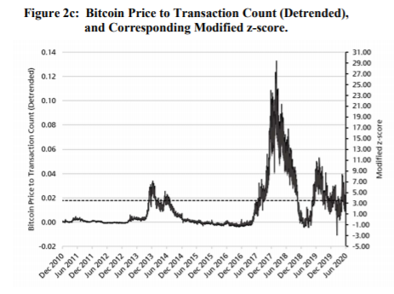
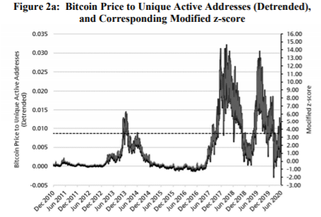
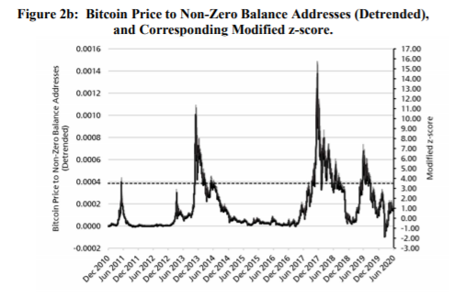
To the Moon A History of Bitcoin Price Manipulation Journal of Forensic and Investigative Accounting, Forthcoming

Slide 5
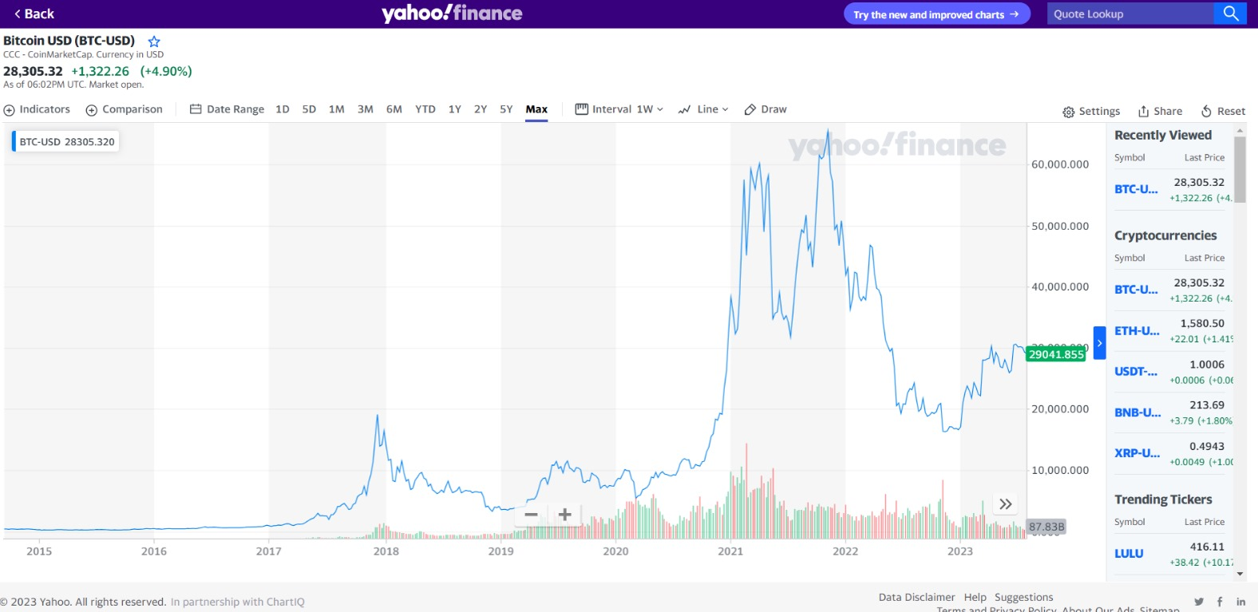
Yahoo Finance Dataset:
We have taken a dataset from the Yahoo finance repository. The dataset includes bitcoin prices from September 17, 2014 to October 14, 2023.

Slide 6
About Dataset:
The dataset we are working on is .csv file.
The dataset includes features with date, open, high, low, close, adj close, and volume.
Date- This is the date on which the data point is recorded.
Open: Price of the asset at the beginning of the trading period
High: Highest price reached by the asset during the trading period
Low: Lowest price reached by the asset during the trading period.
Close: Final price of the asset at the end of the trading period.
Adjusted Close: Accounts for any corporate actions, such as stock splits
Volume: Total number of units of the asset traded during the specified period

Slide 7
Implemented Model
Linear Regression:
Linear Regression (LR) is a predictive model that formulates a line of best fit between a scalar dependent variables and multiple explanatory variables.
Linear Regression is like drawing a straight line through a set of points on a graph in a way that the line is as close as possible to all the points at the same time.
Linear fit occurs by minimizing the mean squared error between the predicted and actual output.
A linear regression line has an equation of the form Y = a + bX, where X is the explanatory variable and Y is the dependent variable.

Slide 8
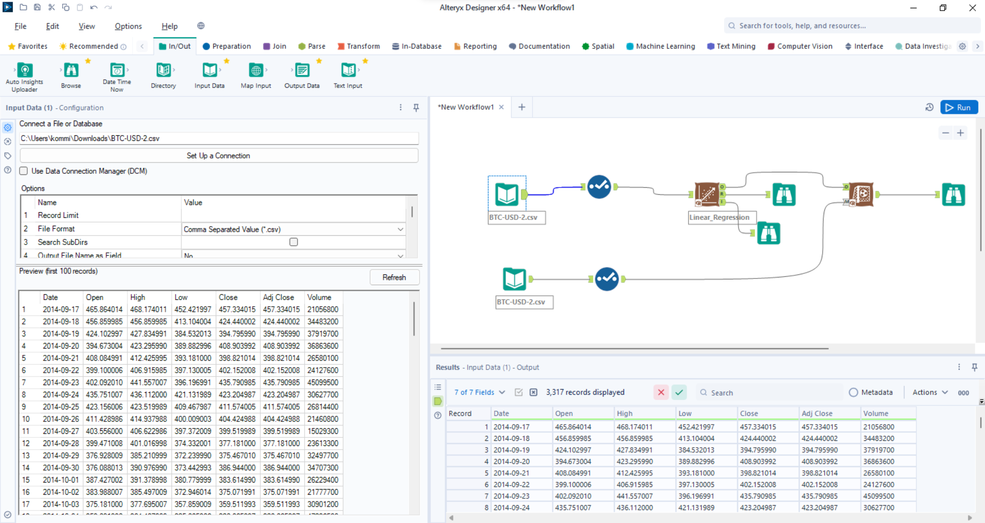
Alteryx Software:

Slide 9
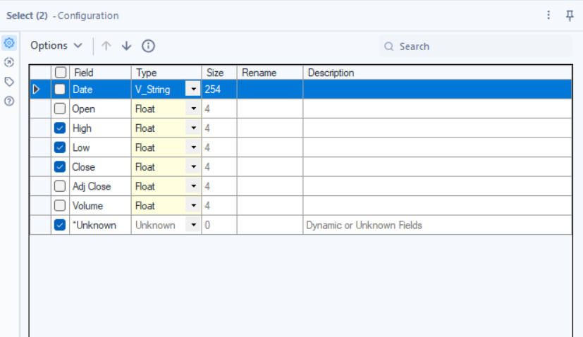
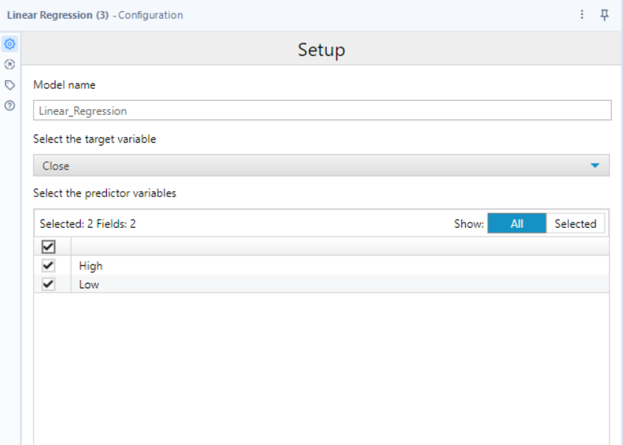

Slide 10
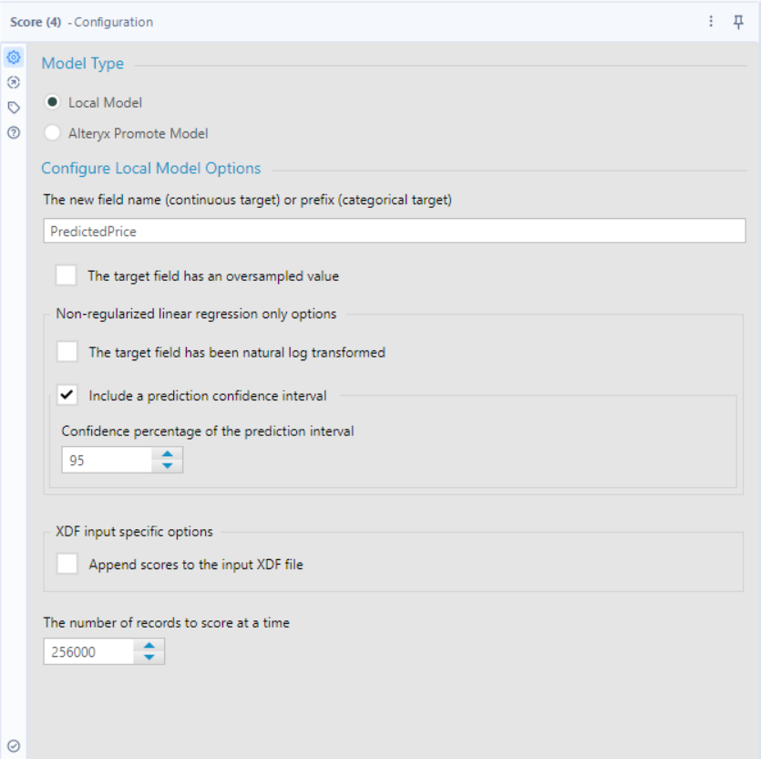

Slide 11
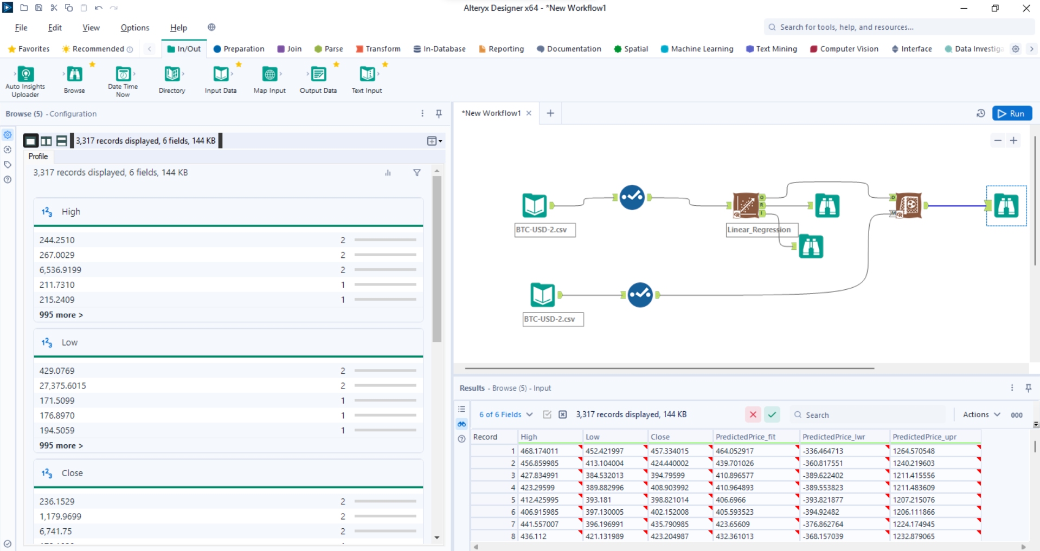

Slide 12
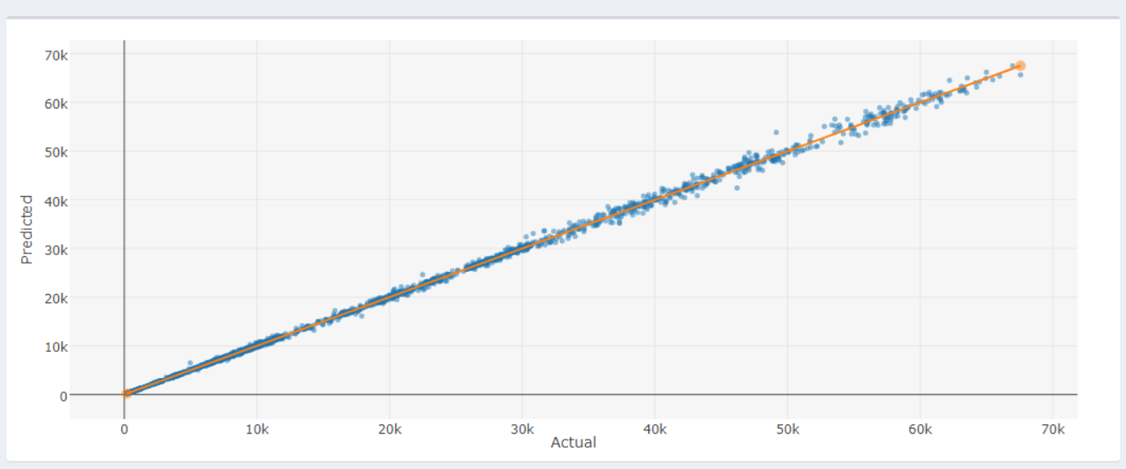

Slide 13
Conclusion
Our study looks closely at how Bitcoin is becoming an interesting option for investors looking for different types of investments.
We've built a model that tries to predict Bitcoin's future value and checked if its price movements make sense with certain financial theories. We used data from September 17, 2014, to October 14, 2023.
By using statistical tools like linear regression and r-squared, we've tried to spot trends in how Bitcoin's price changes. We're trying to see if Bitcoin prices are predictable or if they change randomly. Our research helps people understand more about Bitcoin and can guide investors and traders as they navigate the fast-changing world of cryptocurrencies.

Slide 14
Thank You

